Slide 1
Internship
Progress
Report
Yamaguchi University

Slide 2
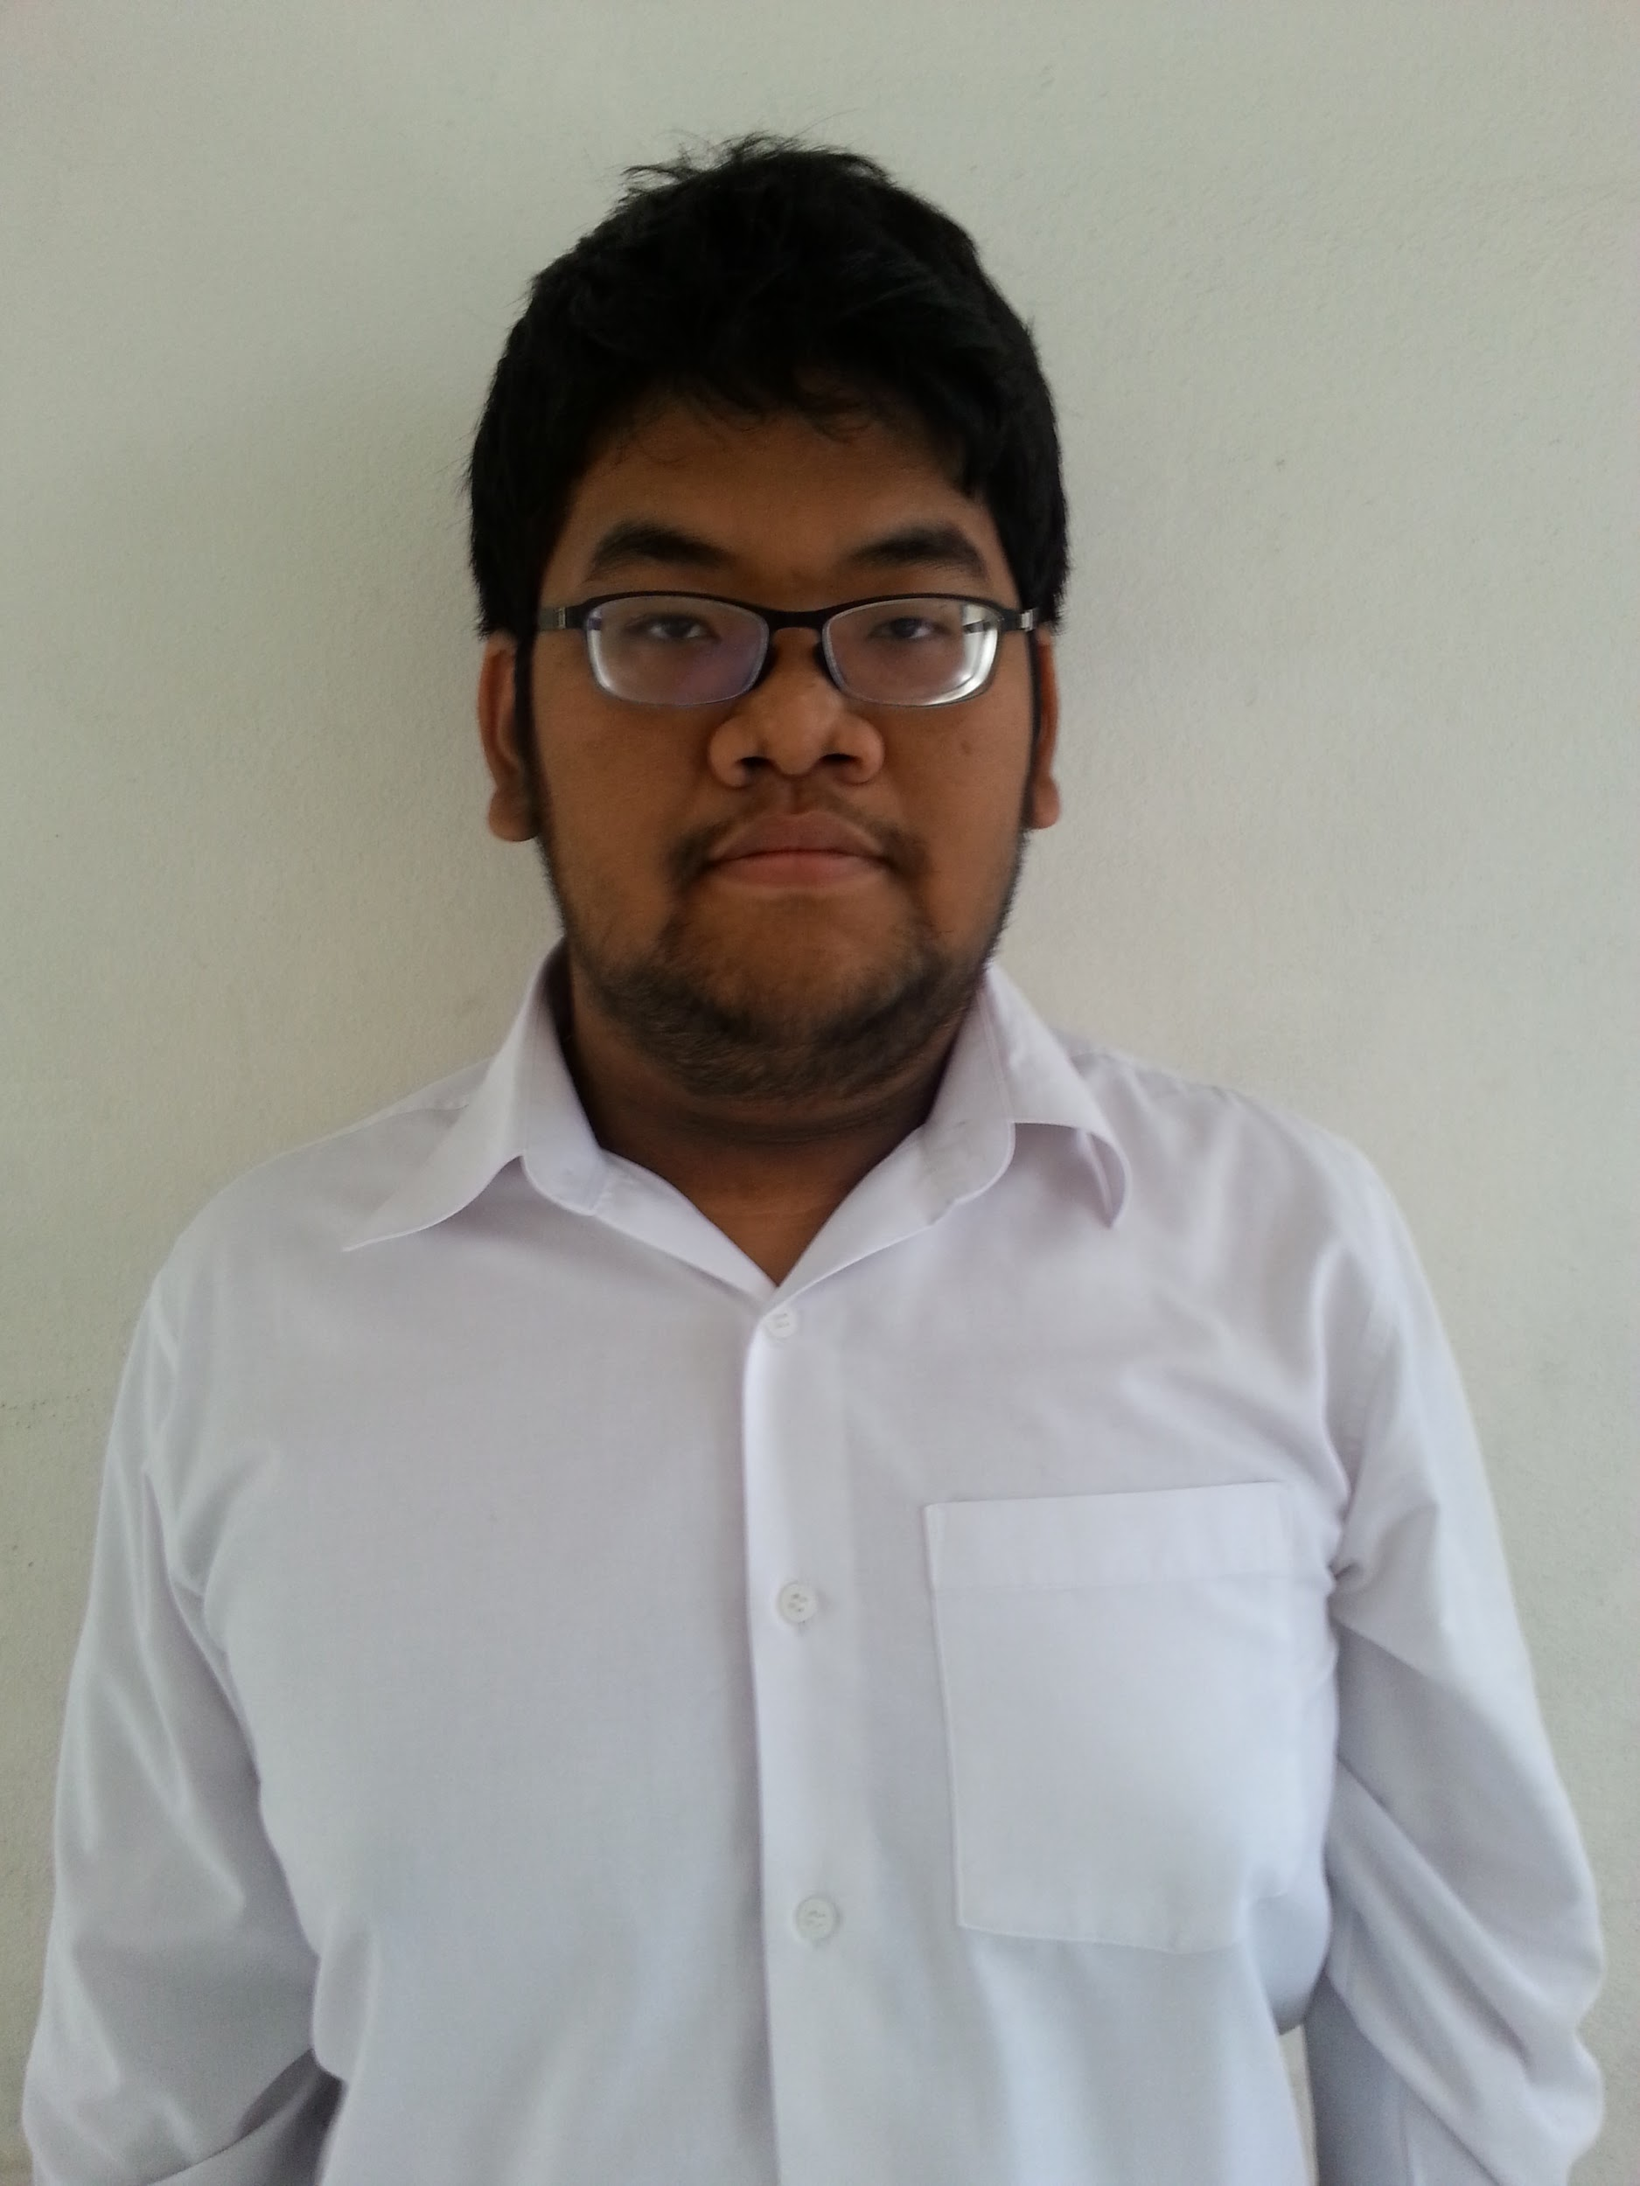
Greeting !
My name is Thanawit Gerdprasert
The presentation will be report about last 6 weeks of the Internship Project

Slide 3


Introduction

Slide 4


What about our project

Slide 5
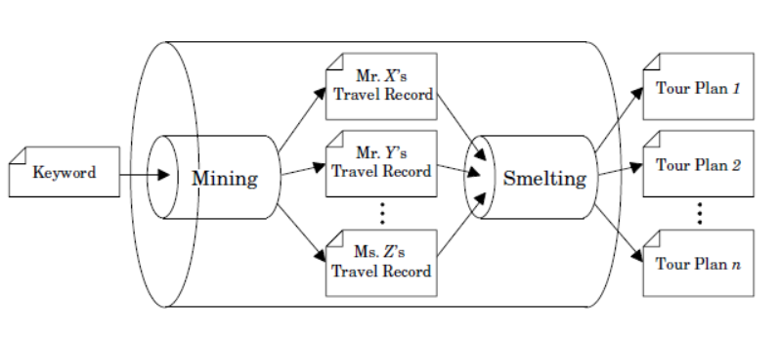
Previous Research
Tour Miner: Mining System of Tour Plans from SNS
Smelting Function from Travel Records to Tour Routes

Slide 6
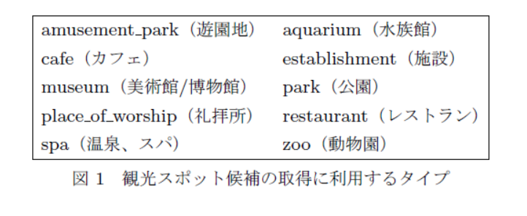
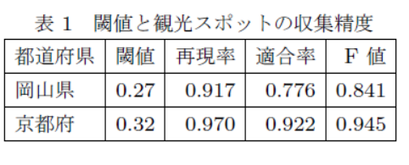
Previous Research
Twitter を利用した観光ルート推薦の一手法
新井 晃平 新妻 弘崇 太田 学

Slide 7
Objective
Crawling the tour record from Social Network System
Suggest or Generate the tour record based on User Preference
Create Web Application for showing the result

Slide 8
Progress so far
What have we done? What will be done?

Slide 9
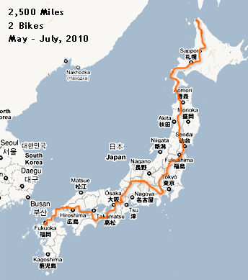
Pulling the record from the Twitter
Get the record from the Twitter via Twitter API by using the various node modules

Slide 10


Create the Database for
storing the tour record
Label the record and clean it to it to be able to function properly in the web application format.

Slide 11


Build Web Application
Create the Web Application in order to get the user input and give the correct record based on the user input

Slide 12
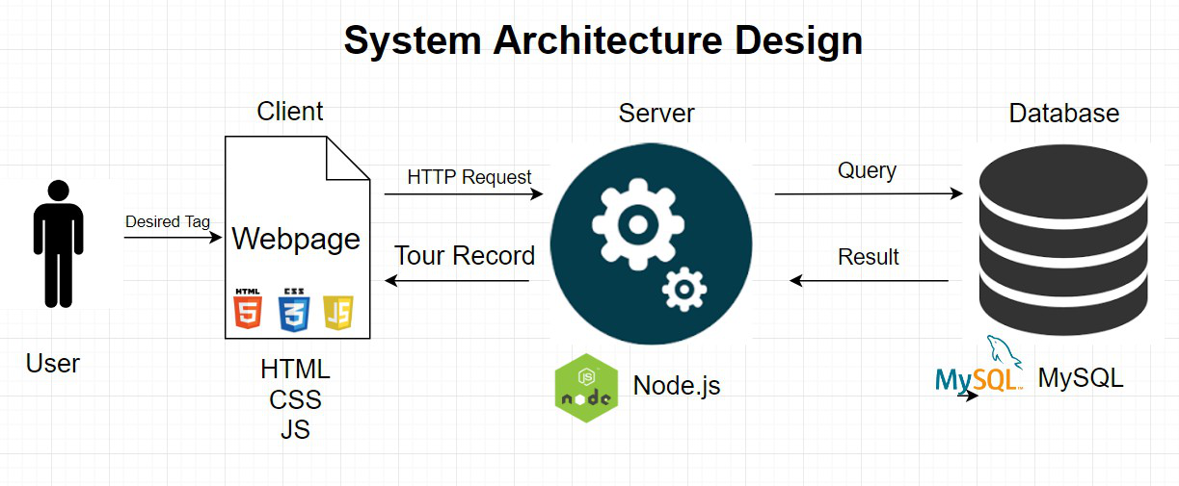
System Architecture Diagram

Slide 13
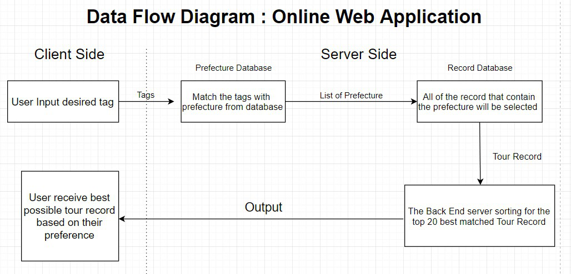
Data Flow Diagram : Online Web Application

Slide 14
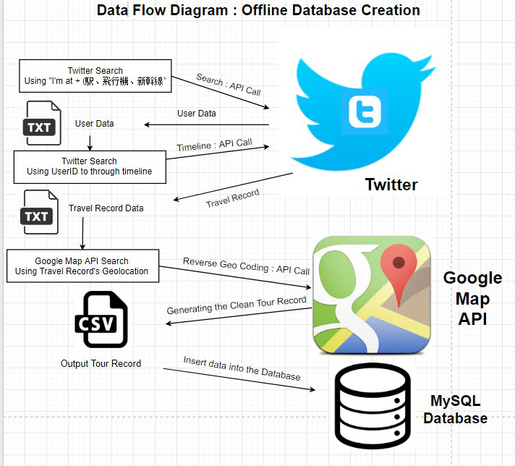
Data
Flow
Diagram
Offline Side

Slide 15
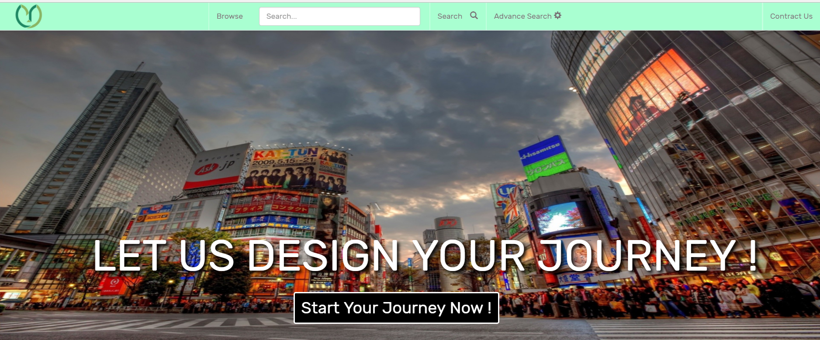
Web Application Demo

Slide 16
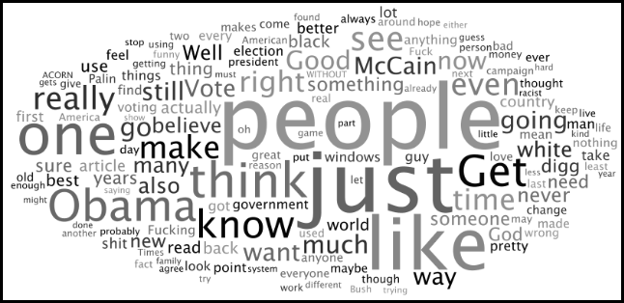

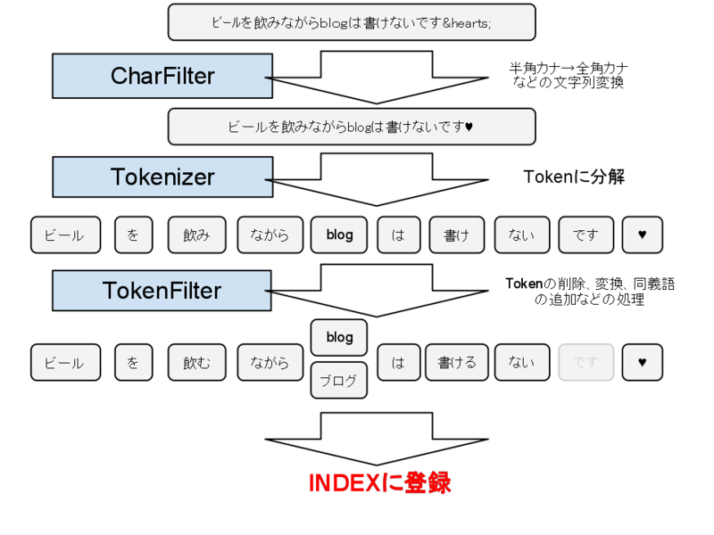
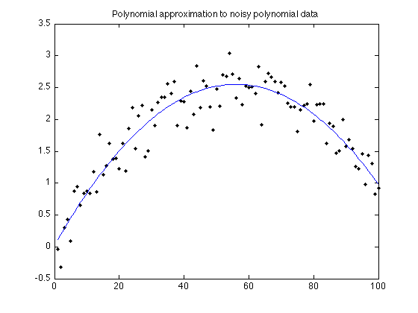
Problem & Struggle

Slide 17
Final Word
Any questions?

Slide 18
THANKS YOU !!!
FOR YOUR ATTENTION

